Slide 1


CodeBasics Resume Challenge
AtliQ Mart
FMCG manufacturer
Optimizing Supply Chain Performance
Report by :
Helly Modi

Slide 2



AtliQ Mart
Executive Summary
AtliQ Mart, a fast-growing FMCG company headquartered in Gujarat, India, operates in Surat, Ahmedabad, and Vadodara, with plans to expand to other metro and Tier 1 cities within the next two years.
Read More

Slide 3


AtliQ Mart
Home
About
Contact
Problem Statement
Why is this project necessary?
AtliQ Mart is currently facing a problem where a few key customers did not extend their annual contracts due to service issues.
It is speculated that some of the essential products were either not delivered on time or not delivered in full over a continued period, which could have resulted in bad customer service.
Management wants to fix this issue before expanding to other cities and requested their supply chain analytics team to track the ’On time’ and ‘In Full’ delivery service level for all the customers daily basis so that they can respond swiftly to these issues.

Slide 4
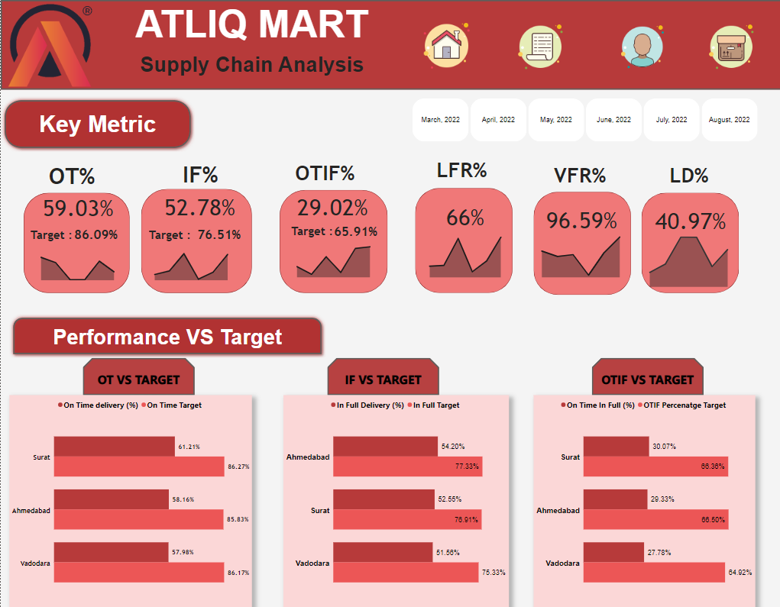
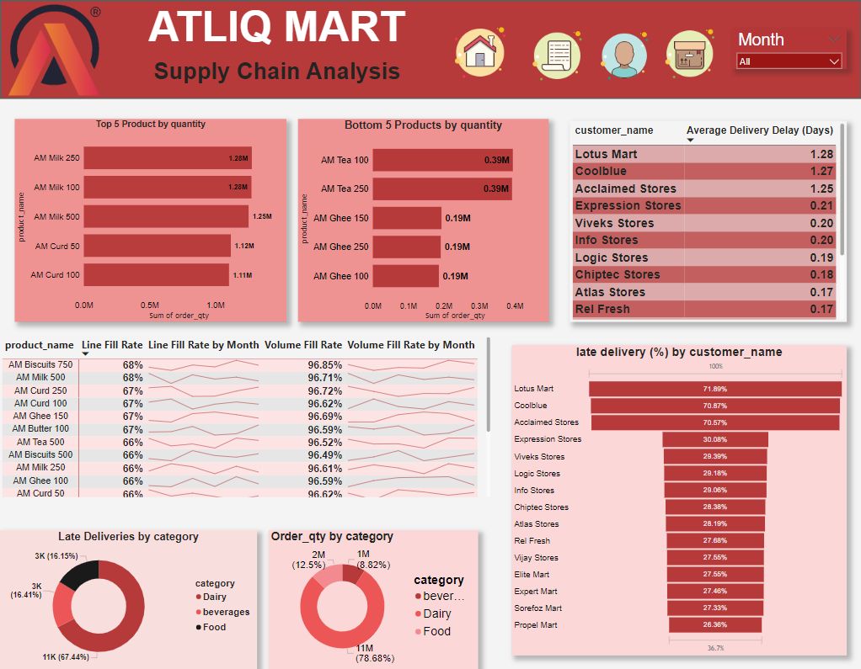
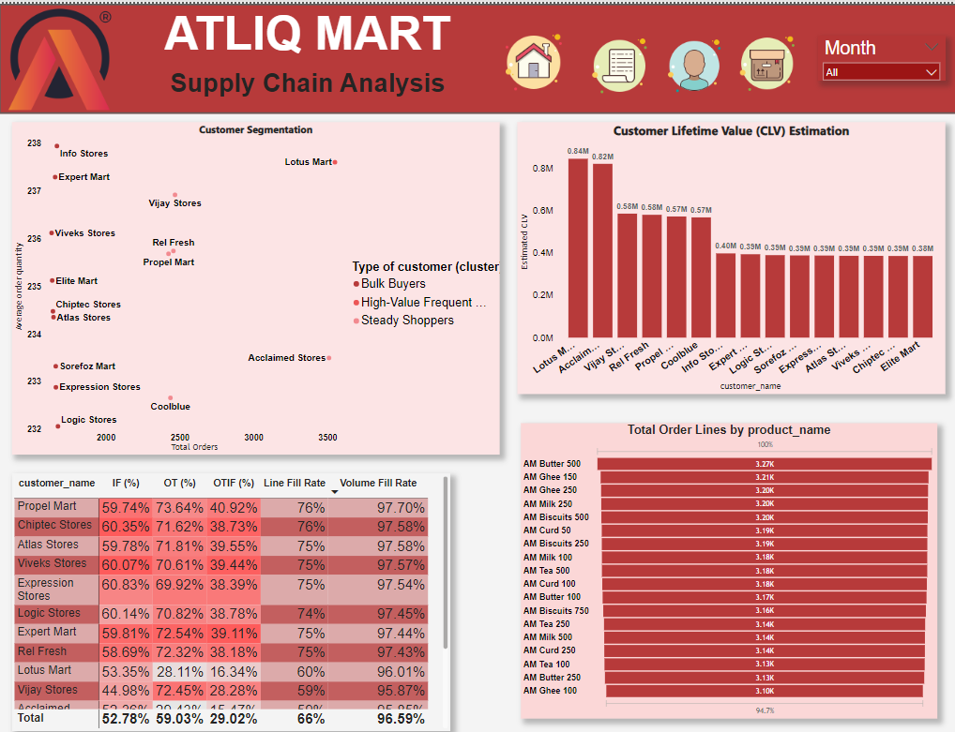
Dashboard

Slide 5
AtliQ Mart
Overview

Slide 6
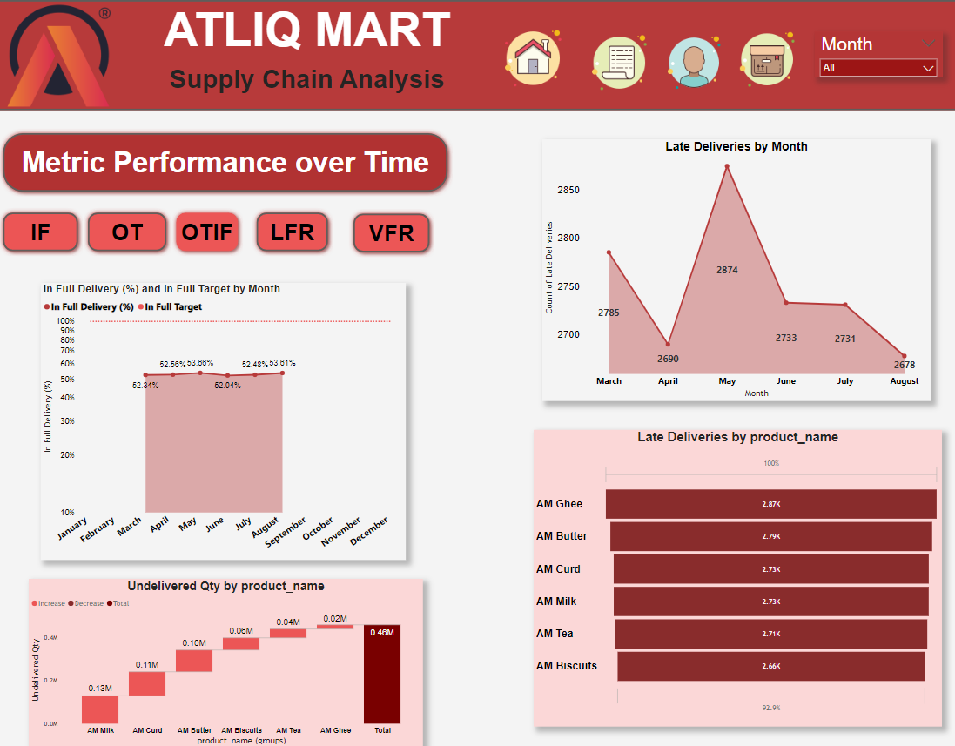
AtliQ Mart
Order
Insights

Slide 7
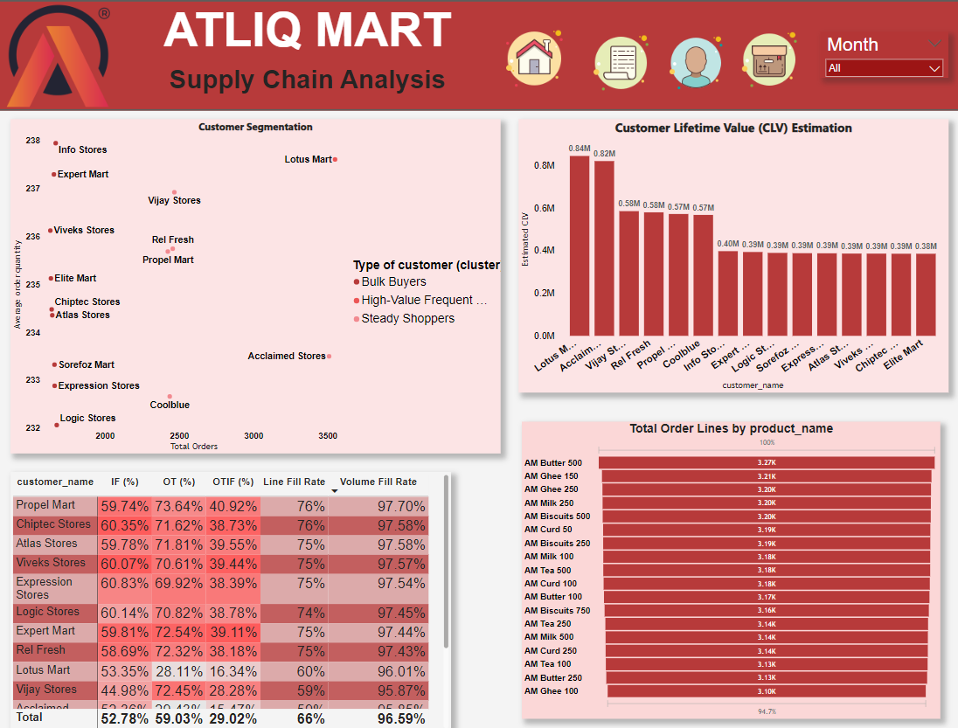
AtliQ Mart
Customer
Analysis

Slide 8
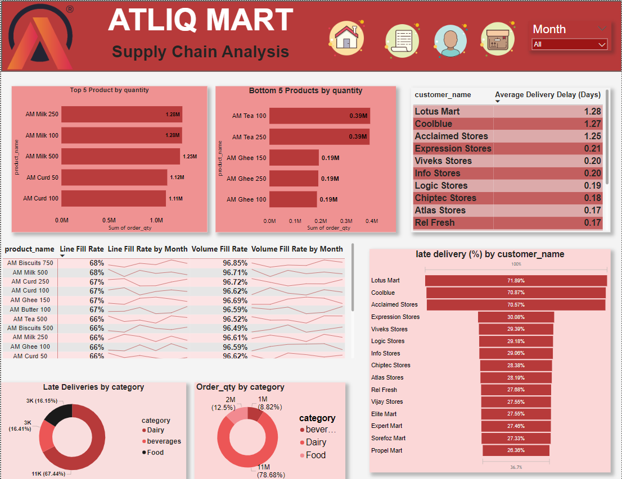
AtliQ Mart
Inventory
Insights

Slide 9
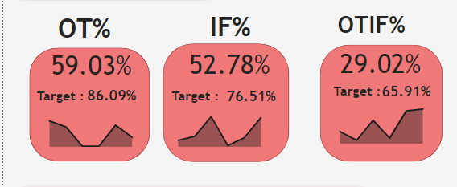
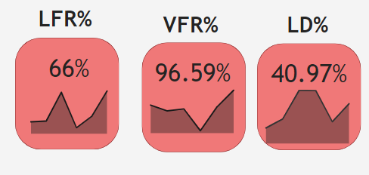
Insights
AtliQ Mart
Contact
OT% (On-Time Delivery Percentage): Achieved 59.03% against a target of 86.09%, showing significant room for improvement.
IF% (In-Full Delivery Percentage): Achieved 52.78% against a target of 76.51%, indicating issues in fulfilling orders completely.
OTIF% (On-Time In-Full Delivery Percentage): Only 29.02% against a target of 65.91%, suggesting that timely and complete deliveries are a significant challenge.
LD% (Late Delivery): At 40.97%, indicating a high rate of delayed deliveries.
LFR% (Line Fill Rate): At 66%, which could indicate partial fulfillment issues.
VFR% (Volume Fill Rate): High at 96.59%, suggesting that while volume targets are mostly met, there may be other gaps in delivery.
On-Time Delivery (OT): Ahmedabad and Surat are close but still below targets, while Vadodara shows the lowest on-time delivery performance.
In-Full Delivery (IF): Ahmedabad performs the best in meeting the "In Full" targets, while Vadodara is slightly lower.
On-Time In-Full Delivery (OTIF): All cities are struggling, with Surat having the highest OTIF rate but still below target. This is an area that needs urgent attention for improvement.

Slide 10
AtliQ Mart
Customer Insights
Customers are segmented into "Bulk Buyers," "High-Value Frequent Buyers," and "Steady Shoppers."
Cluster 1: "Bulk Buyers“
Represents customers with low frequency, high average order size.
These customers purchase large quantities less frequently, aligning with bulk buying behavior.
Cluster 2: "High-Value Frequent Buyers“
Represents the unique customer with high frequency, high average order size.
This segment consists of a highly engaged, high-value customer who orders frequently and in large quantities, possibly a VIP or business account.
Cluster 3: "Steady Shoppers“
Represents customers with moderate frequency and moderate order size.
These are consistent customers who place regular, moderate-sized orders, indicating steady and predictable purchasing behavior
"Lotus Mart" and "Acclaimed Stores" appear as high-value customers with significant order volume, suggesting they could be prioritized for retention efforts.
" Customer Lifetime Value (CLV): Customer Lifetime Value, or CLV, is a way to estimate how much a customer is likely to contribute to our business over the time we have a relationship with them.
we don't have revenue, we can approximate CLV using:
Order Frequency (how often a customer places an order) and Average Order Quantity (the average number of products ordered)
CLV=Order Frequency × Average Order Quantity

Slide 11
AtliQ Mart
Insights
The highest estimated CLV is from Lotus Mart and Acclaimed Stores, making them crucial to AtliQ Mart’s revenue while Elite Mart and chiptec stores contribute the least clv.
Product Demand: The most frequently ordered products include AM Butter (500g), AM Ghee (150g and 250g), and AM Milk (250ml), indicating strong customer preference. Notably, high demand for AM Milk (250ml and 500ml) and AM Curd (500g) suggests a need for efficient inventory management to prevent stockouts. Conversely, low demand for AM Tea (100g) and AM Ghee (50g) points to the need for a reassessment of inventory strategies for these items.
Delivery Performance:
Lotus Mart and Cool Blue experience the longest average delivery delays of 1.28 and 1.27 days, respectively, and exhibit the highest rates of late deliveries, emphasizing the need for improvement in delivery timeliness.
Highest percentage of late deliveries in Dairy, followed by Beverages and Food.
Ghee , Curd and Butter products are the most delayed in delivery.
Butter ,Milk and curd are the most frequently undelivered items.
May has the highest number of late deliveries, with 2874 occurrences, followed by a gradual decrease to 2678 in August.
The customers potentially at risk of churning include Acclaimed Stores, Lotus Mart, and Cool Blue. Their low OTIF performance, frequent late deliveries, significant delays, and inability to receive all ordered products highlight their challenges. These clients are critical to the business, as they contribute substantially to overall revenue.

Slide 12

Contact
Thank You For
Attention
See You Next
By : Helly Modi

